Slide 1


Slide 2
Artificial Neural Network basics
Qingkai Kong
2016-12-02
http://seismo.berkeley.edu/qingkaikong/

Slide 3
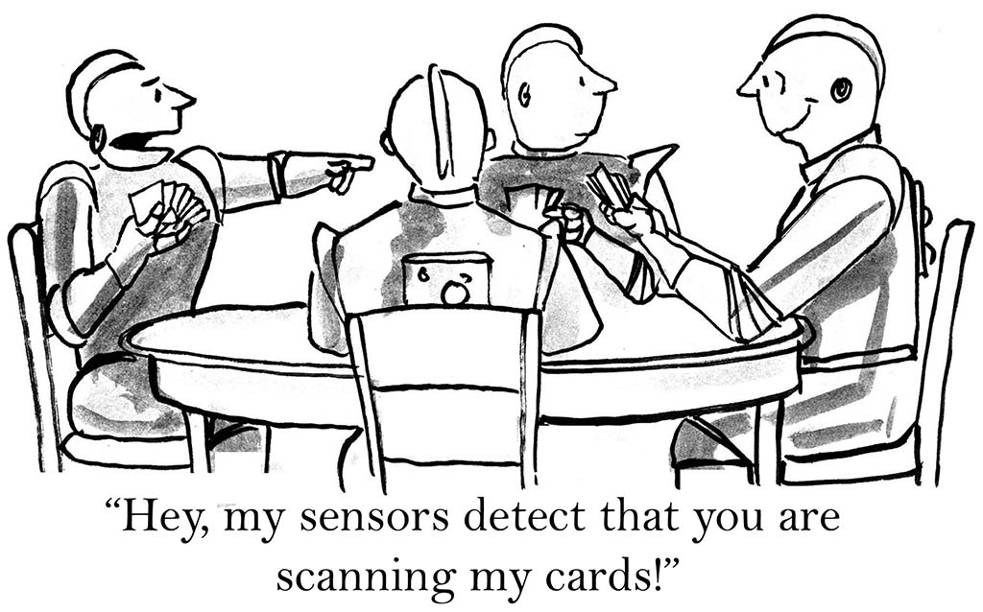

Slide 4
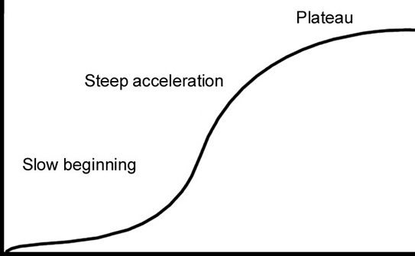
Real world example
Step by step ANN
Learning curve
Gentle introduction
Workshop time

Slide 5
Real world example
Step by step ANN
Learning curve
Gentle introduction
What’s ML
ANN history
ANN overview
Workshop time

Slide 6

What is machine learning?

Slide 7
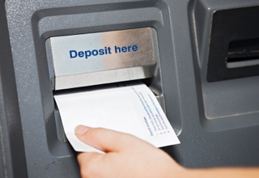
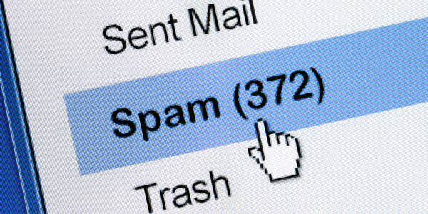
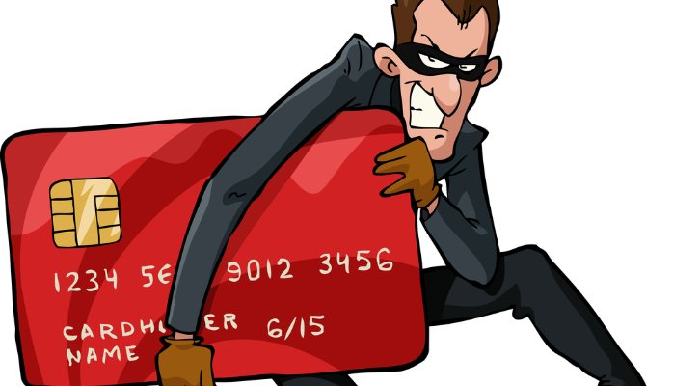
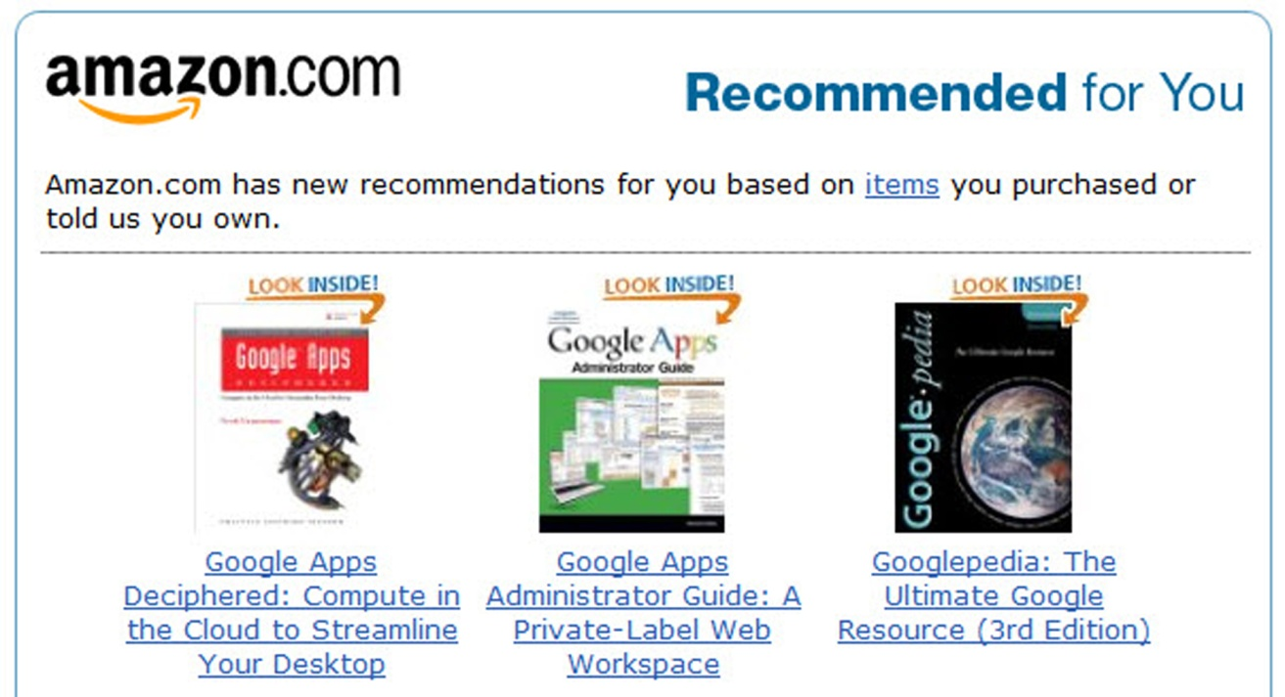
Self-driving car
Voice recognition
…

Slide 8
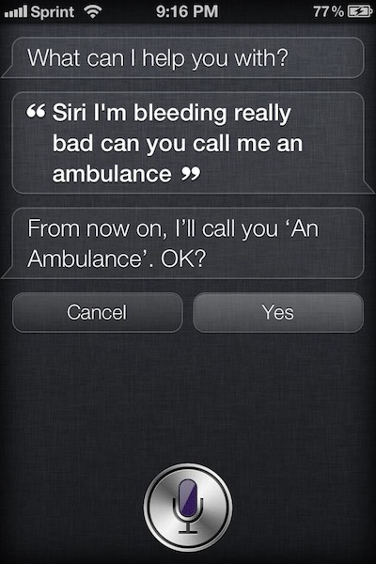
Not always working

Slide 9
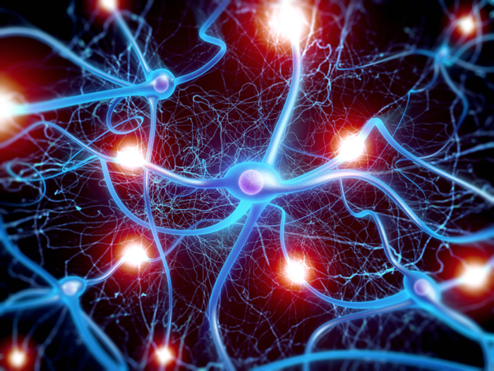

Slide 10
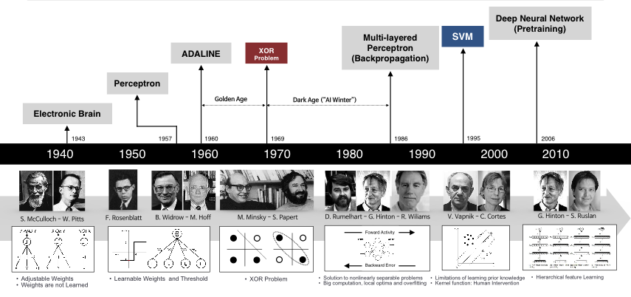
1980s
Rebirth
2006
Deep
1970s
Winter
1940s
Birth

Slide 11
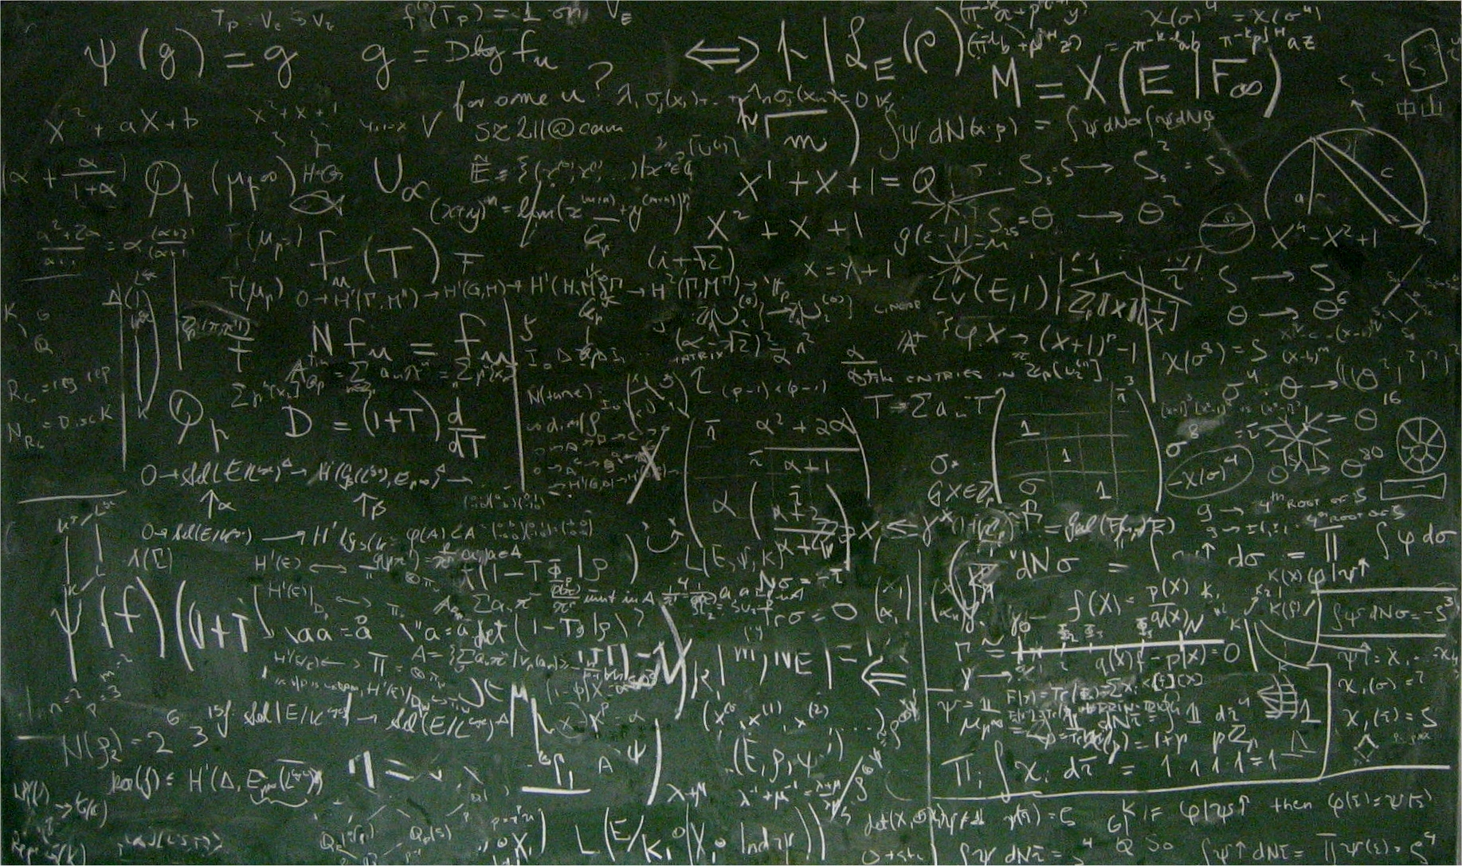


Slide 12
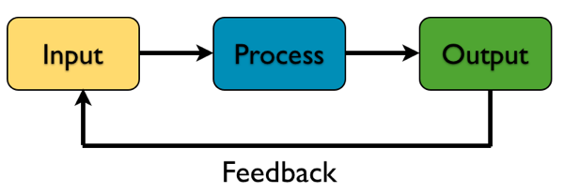

Slide 13
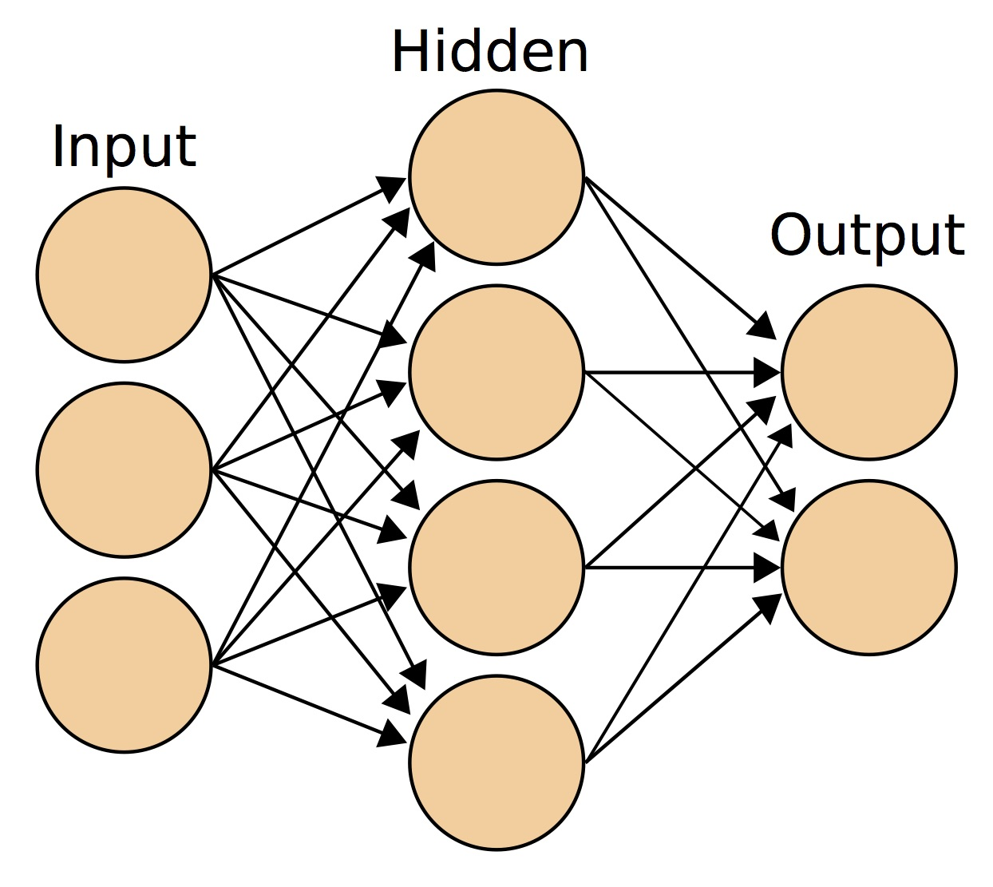
Notes:
It's a mathematical construct to fit a model to historical data, and use this model to forecast the future.

Slide 14
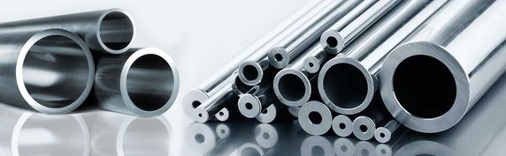

Slide 15
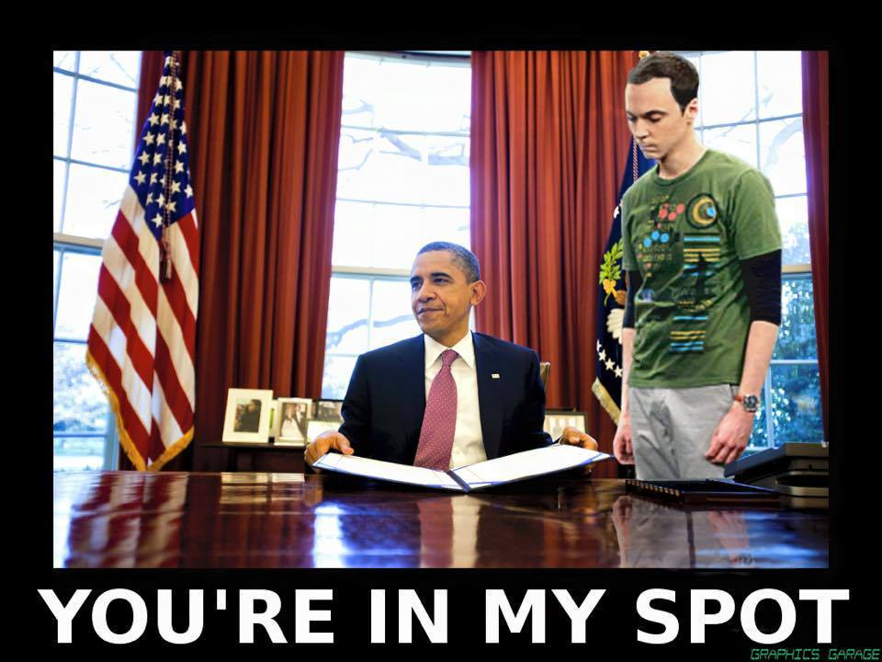

Slide 16
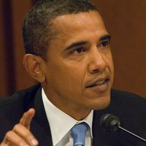
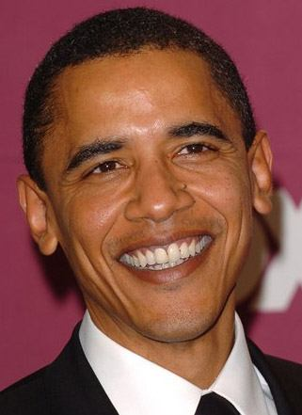
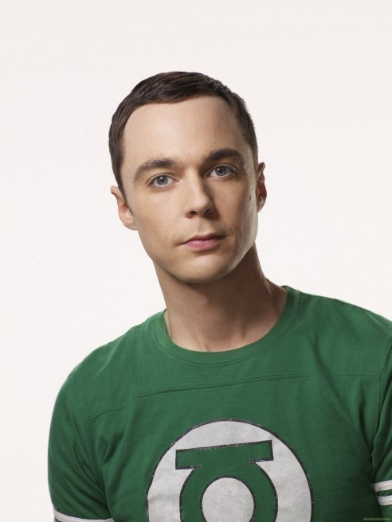
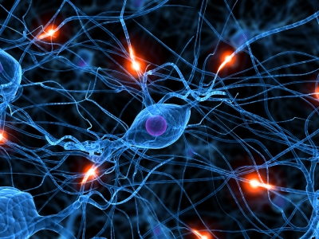
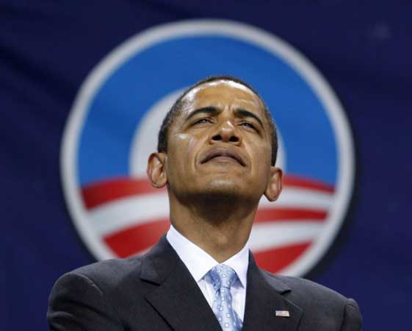
Intuitive Artificial Neural Network
Input
Output
w₁
F(eye×w₁+nose×w₂+…+mouth×w_{n})
w₂
Sheldon Cooper?
.
.
.
w_{n}

Slide 17
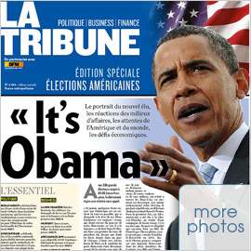
Intuitive Artificial Neural Network
Input
Output
w₁
F(eye×w₁+nose×w₂+…+mouth×w_{n})
w₂
Sheldon Cooper?
.
.
.
w_{n}
feedback

Slide 18
Intuitive Artificial Neural Network
Input
Output
w₁
F(eye×w₁+nose×w₂+…+mouth×w_{n})
w₂
Sheldon Cooper?
.
.
.
w_{n}
feedback

Slide 19
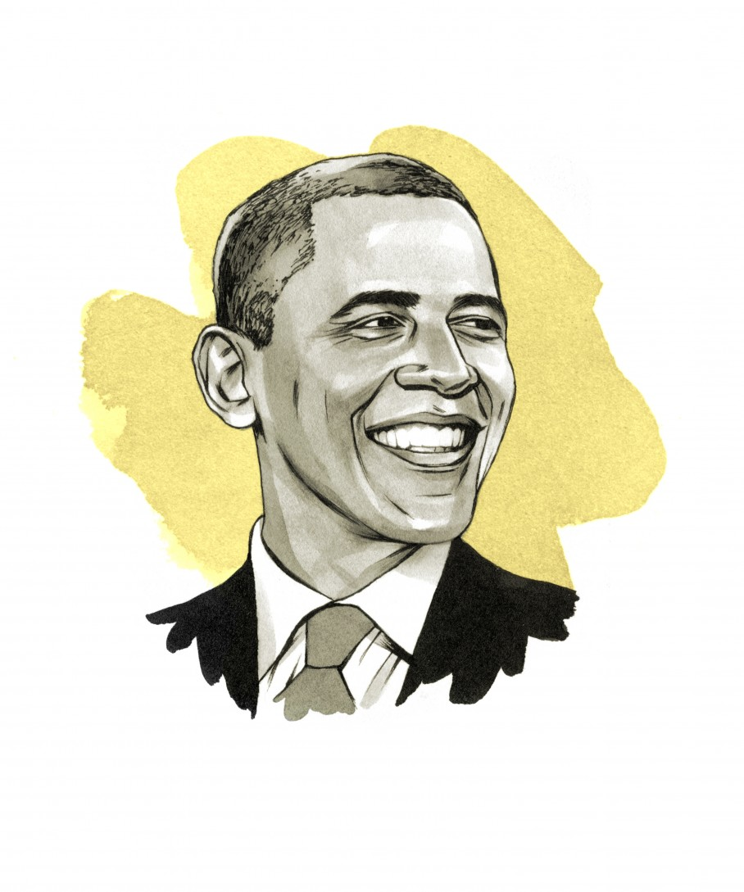
Intuitive Artificial Neural Network
Input
Output
w₁
F(eye×w₁+nose×w₂+…+mouth×w_{n})
w₂
.
.
.
w_{n}

Slide 20
Real world example
Step by step ANN
Perceptron
Backpropagation
Learning curve
Gentle introduction
What’s ML
ANN history
ANN overview
Workshop time

Slide 21
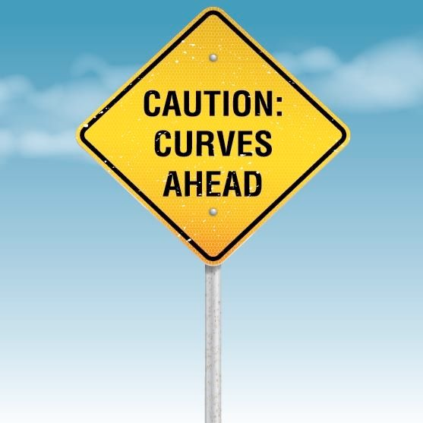

Slide 22
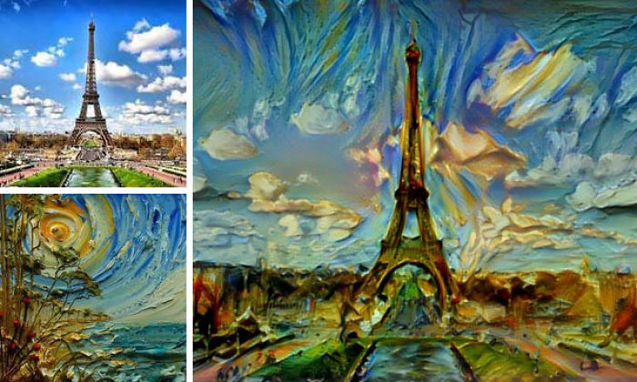
Learn arts
https://arxiv.org/abs/1508.06576v1
https://deepart.io/

Slide 23
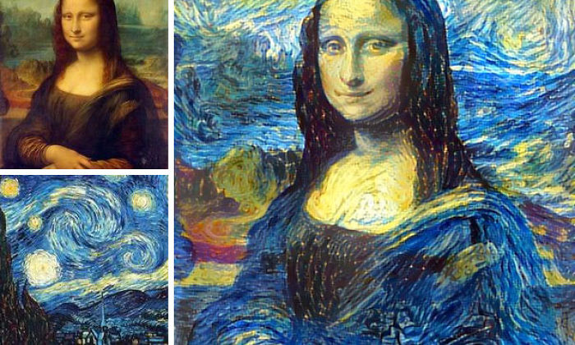
http://junkhost.com/2016/03/man-combines-random-peoples-photos-using-neural-networks-and-the-results-are-amazing/

Slide 24
Go to notebook 01

Slide 25
Real world example
Sklearn example
Step by step ANN
Perceptron
Backpropagation
Learning curve
Gentle introduction
What’s ML
ANN history
ANN overview
Workshop time

Slide 26
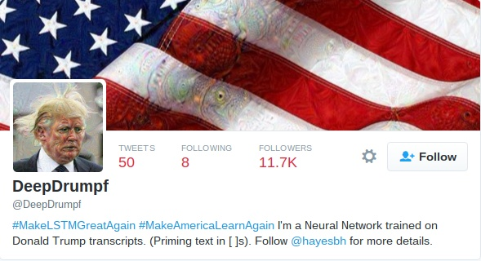
DeepDrumpf
https://twitter.com/DeepDrumpf
https://www.pastemagazine.com/articles/2016/03/an-mit-scientist-created-a-trump-twitter-bot-and-i.html

Slide 27
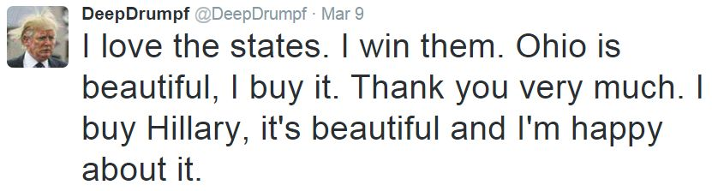
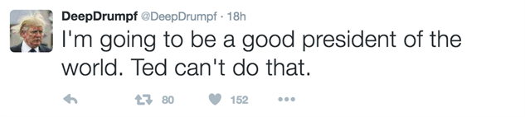

Slide 28
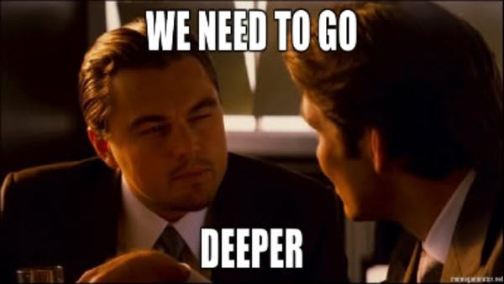

Slide 29
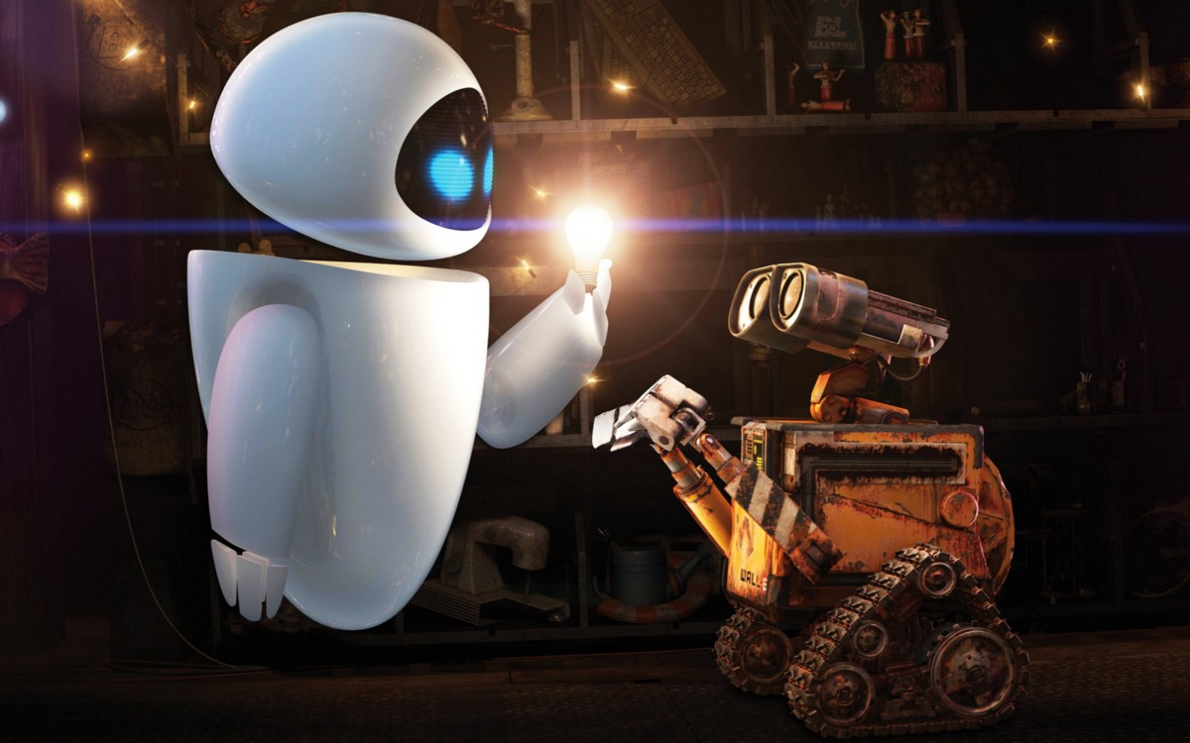

Slide 30
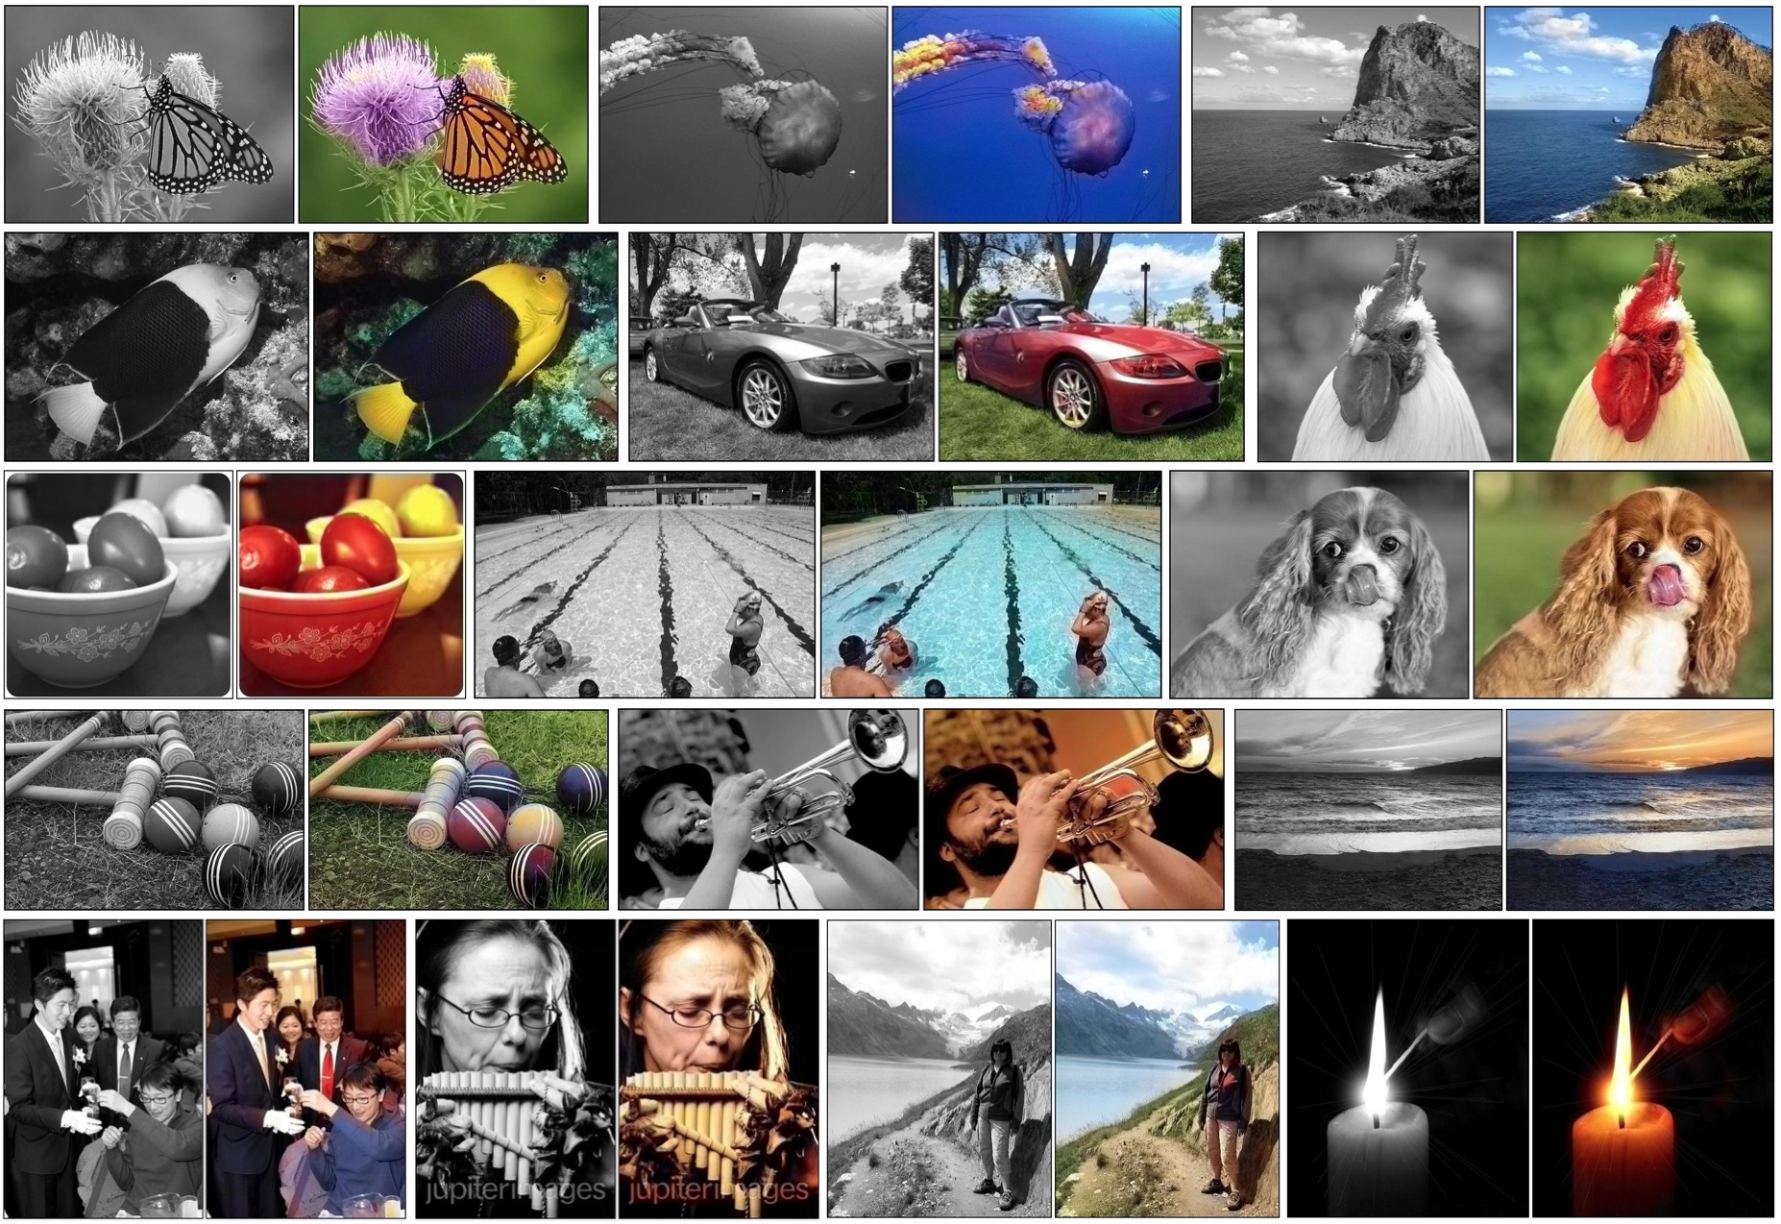
http://whattogive.com/videoColourization/
http://richzhang.github.io/colorization/

Slide 31
https://www.youtube.com/watch?v=tWdaMKKH5MI

